Slide 1
Corporate and foundation FundiNG 2025 - 2026
Notes:
Click new slide in the menu bar then select template of choice for title slide and title/text slide formats. You can choose from various colors and textured backgrounds. Displayed is suggested font size and color.

Slide 2
The Office of Corporate and Foundation Relations at the WVU Foundation provides services and support to facilitate philanthropic relationships and investments with and for the WVU community,
across West Virginia University and its Health System.

Slide 3
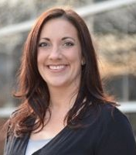
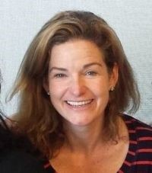
Heather Cross
Executive Director of Corporate and Foundation Relations
West Virginia University Foundation
Elizabeth Thompson
Director of Foundation Relations
West Virginia University Foundation
Heather serves as the Executive Director of Corporate and Foundation Relations at the WVU Foundation, where she builds and strengthens relationships with national foundations and industry partners. In collaboration with development staff and faculty across West Virginia University and its Health System, she develops long-term strategic partnerships that generate funding for evolving needs. With 20 years of fundraising experience, Heather has served WVU since 2015, holding a CFRE and MBA.
Elizabeth serves as the Director of Foundation Relations on the WVU Foundation's Corporate and Foundation Relations team. In this role, Elizabeth concentrates primarily on private foundation relationships in support of opportunities and needs across the University. With a background in fundraising for social services, as well as her CFRE and MPA, Elizabeth is proud to be part of the WVU team.

Slide 4
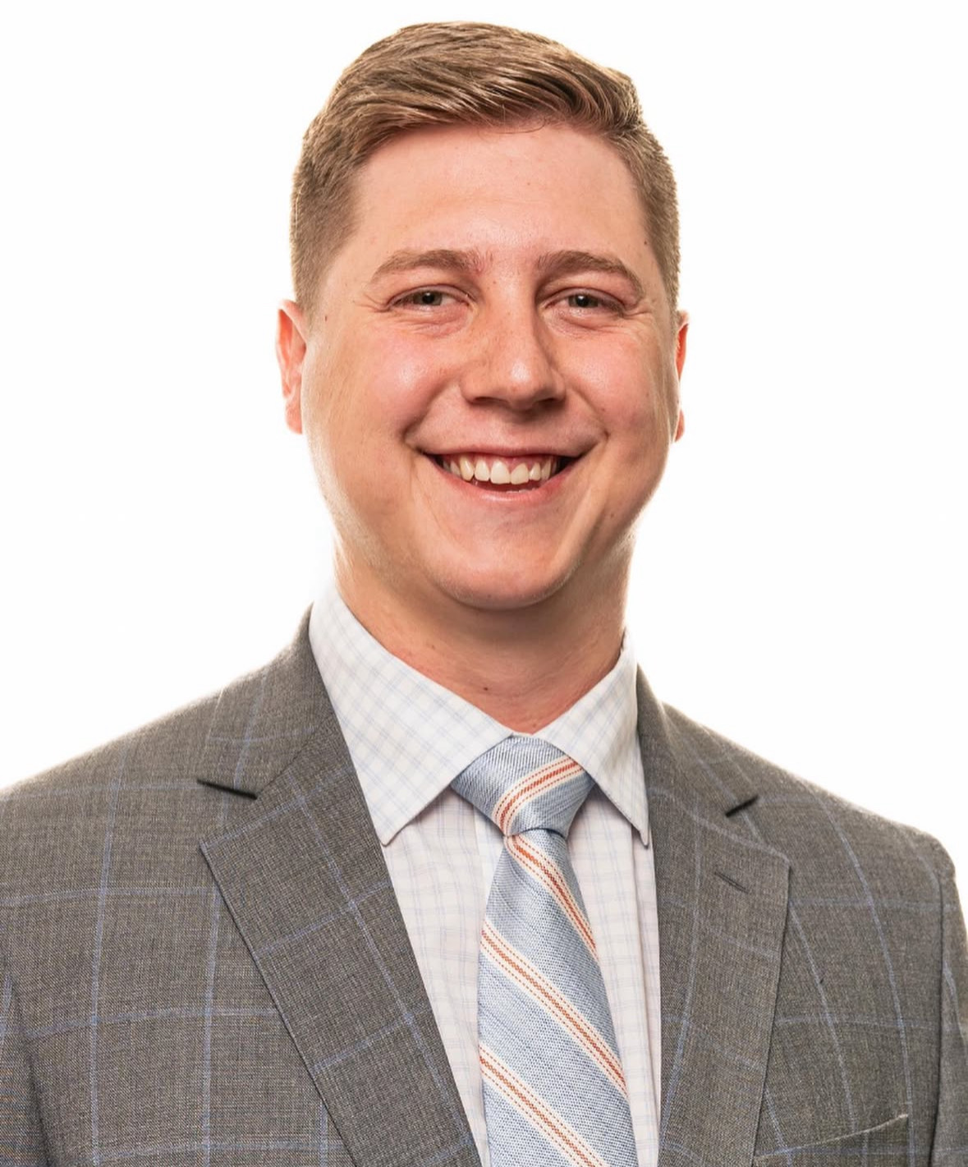
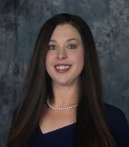
Haden Miller
Director of Corporate Relations
West Virginia University Foundation
Jill Zangari
Director of Operations and
Support
West Virginia University Foundation
Haden serves as the Director of Corporate Relations at the WVU Foundation, where he builds and strengthens relationships with local, regional, and national industry partners. Prior to joining WVUF, Haden served as Field Representative to US Senator Shelley Moore Capito & Political Director for Moore Capito’s campaign for Governor. Since graduating from WVU in 2020, Haden has built a background in government and public relations through the state of West Virginia.
Jill serves as the Director of Operations and Support on the WVU Foundation's Corporate and Foundation Relations team. Jill works strategically with units across the University to provide post-award support and guidance for grants housed at the WVU Foundation. This entails working to ensure accurate reporting for awards and assistance with fund management including balance and transaction requests.

Slide 5
How WVUF CFR Helps:
Prospect Research and Identification
Proposal Development Assistance
Relationship Building and Facilitation
Strategic Alignment (internal and external)
Grant Management and Stewardship
Navigating Institutional Processes and Compliance

Slide 6
Foundation or OSP?
Idea
Funder: Private or Govt.
Private
Corporations, Foundations, Organizations
Government
State, Local, Federal,
Pass-through
Compliance Issues/IRB
Animals, Human Subjects,
Radiation, Deliverables, IP
No
Yes
Foundation
OSP (WVURC)
Notes:
Example slide with title and text in two column format - Gold background with line texture.

Slide 7
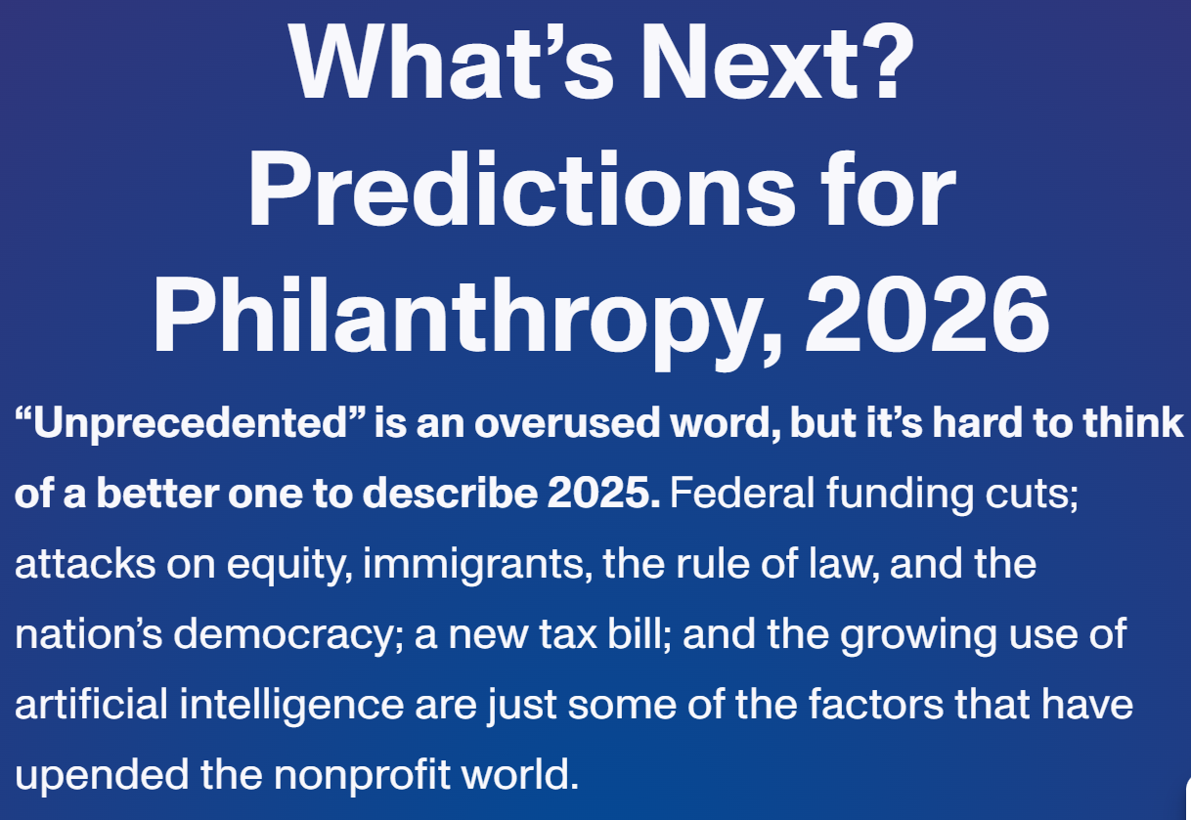
Chronicle of Philanthropy – Nov/Dec 2025

Slide 8
Foundation Trends: The Year to Come
Another record year for foundation giving due to equity market returns; 5-7% increase to approx. $120 billion based on $1.75 trillion in foundation assets.
Education typically 14-18% of total.
Alignment: “Foundations dig in to maintain or accelerate progress on their missions, whether protecting public media in small markets or preserving arts and culture programs.”
AI, especially responsible, human-centered uses.

Slide 9
Corporate Trends: The Year to Come
Corporate giving is expected to continue to grow, though at a slower pace than in previous years, influenced by economic uncertainty and new tax policies.
1% Tax Floor: Corporations will need to contribute at least 1% of taxable income before charitable gifts qualify for a deduction and the 10% ceiling remains, meaning only the amount between 1% and 10% is deductible in a given year (subject to 5-year carryforward rules).
Expected Impacts:
Focus on Systemic Change: Push toward providing unrestricted, trust-based, and long-term support to address the root causes of social problems, rather than short-term, restricted grants
Strategic Shift: With tax benefits diminished, companies will likely place more emphasis on the strategic value of their giving programs, ensuring they align with their overall business and sustainability objectives to demonstrate a return on investment.
Greater Focus on Impact: Establishing key performance indicators (KPIs) to evaluate program effectiveness, guide funding decisions, and drive measurable outcomes.
“Bunching Behavior”: Concentrating multiple years of donations into a single year to exceed the threshold.
Greater Reliance on Corporate Foundations: Moving funds to a nonprofit foundation constitutes a charitable gift. More companies may combine “bunching” tactics to move money into sheltered vehicles such as a foundation or donor advised fund to be allocated to the community in a smoother set of distributions to the community over multiple future years.

Slide 10
Federal vs. Foundation Funding
All foundations are different.
Foundations can be more opaque than government funders.
Foundations look for alignment with their own individual missions.
Application processes for foundation grants can be iterative.

Slide 11
Myths
Truths
Myth 1: Federal money dried up, so your best bet is private philanthropy.
Truth: Federal funding is likely to remain a cornerstone of durable, multi-year revenue. The headline noise obscures that reality.
Truth: Sometimes faster, yes; often invite-only, narrower, or one-year. As submission counts rise, “friendlier” does not translate to “more likely.”
Myth 2: Foundations are faster and friendlier, so it is “easier” money.
The truth: Strong writing matters, but even more so do relationships, fit, timing, and structural constraints like portfolio limits. This is where to focus your strategy.
Myth 3: If you just write a stronger proposal, you will break through.
Source: Jezreel Consulting

Slide 12
Corporate Funding
Strategic partnerships
Mutually beneficial
Various types of support
grants, gifts in-kind, sponsorships
Reasons Corporations Give to WVU:
Funding for research aligned with their business interests
Access to students/Workforce development
Corporate social responsibility strategy ➝ positive community image
What to Expect:
Annual gifts (multi-year pledges uncommon)
Program based

Slide 13
Process Points
Scope of Relationship across WVU
Alignment
Timing
Concept Paper
Limited Submissions
Designated Point of Contact
Fund Creation
Reporting
Stewardship/Relationship Management
Collaboration

Slide 14
WVU FY26 Collaborative WVUF CFR Foundation & Corporation Projects
Qualcomm: Eberly Data Science Grant & Faculty July 2025
EQT Foundation: WVPEC Steam-TAC July 2025
RWJ Foundation: Health Affairs Institute August 2025
Templeton Foundation: Chambers Business Ethics September 2025
Deswick Canada: Statler Software October 2025
National Marine Sanctuary Fdn: Davis Whale Project October 2025
Greater Kanawha Valley Foundation: CVRP October 2025
Mellon Foundation: Higher Education in Prison November 2025
Huntington Bank: Woodburn Hall Lighting November 2025
Northeast Natural Energy: Woodburn Hall Lighting November 2025
Benedum Foundation: Eberly CRC Invited December 2025

Slide 15
Questions?
Heather Cross
Executive Director of Corporate and Foundation Relations
hcross@wvuf.org
Elizabeth Thompson
Director of Foundation Relations
ethompson@wvuf.org
Haden Miller
Director of Corporate Relations
hmiller@wvuf.org
Jill Zangari
Director of Operations and Support
jzangari@wvuf.org

